Slide 1

Senior Design Project I
Week 2: ASL Translation through a Convolutional Neural Network
Presenter: Josheb P. Dayrit
Notes:
Did some reading on a Stanford paper related to ASL translation using an AI.

Slide 2

A Stanford Paper by Garcia and Viesca
Overview
utilized a pre-trained Google AI (GoogLENet)
Additional datasets: ILSVRC2012 dataset (dataset from an AI competition in 2012), as well as the Surrey University and Massey University ASL datasets. Datasets were images.
The outcome:
consistently classifies letters a-e correctly with first-time users,
correctly classifies letters a-k in most cases.

Slide 3
A Stanford Paper by Garcia and Viesca
Metrics
First, top-1 val accuracy: percentage where AI guesses correct right from the get-go.
Second, top-5 val accuracy: percentage where AI guesses correct within the first 5 attempts.
Additional terminology:
1_init: default learning rate.
2_init: learning rate was increased.
full_lr: learning rate was set to max (1).
Batch: number of samples per training cycle is increased.
Learning rate and number of samples per training cycle were expected to affect accuracy values.
Notes:
Metrics used to quantify their results.

Slide 4
A Stanford Paper by Garcia and Viesca
Results
First, top-1 val accuracy:
Range: from 0.6585 to 0.9782 with different settings (1_init, 2_init, full_lr, batch).
High vacillation. Outlier is 0.9782 (most were between 0.6 to 0.7).
Second, top-5 val accuracy:
Range: from 0.8970 to 1 with different settings (1_init, 2_init, full_lr, batch).
Stable accuracy values, overall.

Slide 5
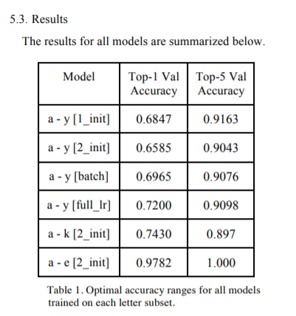
A Stanford Paper by Garcia and Viesca

Slide 6
A Stanford Paper by Garcia and Viesca
Limitations
Camera-related:
lighting,
resolution,
Sensitivity.
AI-related:
Knowing when a sign ends and the next begins.
Distinguishing between successive signs (multiple signs done one after the next).

